Slide 1
Sensu
Don’t Panic

Slide 2
Sensu Overview
RabbitMQ is the central communication point between clients and servers
Sensu server create subscriptions, sets of checks that clients can subscribe to
Sensu clients can create standalone checks and can send the results to the server
Sensu can alert on checks and metrics
Sensu is an ‘event router’ to different handlers
Sensu server can route events/metrics to graphite

Slide 3
Running checks in subscription mode
Server defines ‘subscriptions’ that a client can subscribe to
Periodically server calls for subscription topic checks to be run by posting to RabbitMQ
Client polls RabbitMQ, finds check group it is subscribed to and runs the check commands locally
Client posts results to RabbitMQ
Server picks up check results and handles them

Slide 4
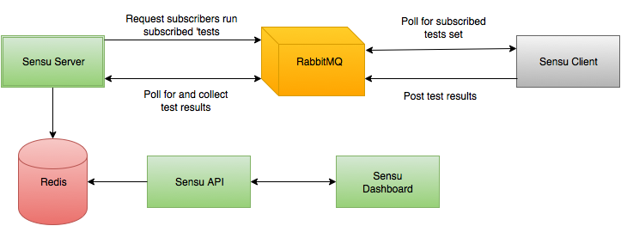
Running checks in subscription mode

Slide 5
Running checks in subscription mode
We can pass in event data into our subscription checks to allow for per-client customisation
Server config
  "cron": {
  "command": "check-something.rb –host ":::project.url | unknown:::”,
  ….

Slide 6
Running checks in subscription mode
Client then sets custom event data
Client config
  "client": {
  "name": "myproject",
  "project": {
  "url": www.sensuisfun.com,
  …

Slide 7
Running checks in standalone mode
Client defines its own check
Client runs check and posts to RabbitMQ
Server polls RabbitMQand finds new result from unknown client
Server creates JIT client for results and handles

Slide 8
Combining subscriptions and standalone
Large amount of check ‘groups’ can be created in the central server covering most use cases
Clients can subscribe to the check groups relevant to them
Clients can use variables to customise subscribed checks
Clients are auto-registered using heartbeats
Client can also run standalone checks that are specific to their setup and not covered by a subscribed group
Server will automatically collect standalone check results

Slide 9
Sensu Peering
Put sensu in its own unique VPC
  vpc:
  CIDR: 10.66.0.0/24
  SubnetA: 10.66.0.0/28
  SubnetB: 10.66.0.16/28
  SubnetC: 10.66.0.32/28

Slide 10
Sensu Peering
Add security groups to open rabbitmq to private ips
    # cloudformation/template.yaml
    PrivatePeeringSG:
    - IpProtocol: tcp
    FromPort: 5672
    ToPort: 5672
    CidrIp: 10.0.0.0/8

Slide 11
Sensu Peering
Create project stack with peering details
  # cloudformation/template.yaml
    vpc:
    peering:
    sensu-dev-: "*”
Peer project stack to sensu stack
$ fab enable_vpc_peering

Slide 12
Sensu Peering
Point sensu-client at private-ip of central sensu rabbitmq
  # /etc/sensu/conf.d/client.json:
    sensu:
    rabbitmq:
    host: 10.66.0.1
    port: 5672
    vhost: "/"
    user: "guest"
    password: "guest"

Slide 13
Sensu Peering
Point sensu-client at private-ip of central sensu rabbitmq
      sensu:
      rabbitmq:
      host: 10.66.0.1
      port: 5672
      vhost: "/"
      user: "guest"
      password: "guest"

Slide 14
Sensu Peering - Issues
External stacks must know the private IP address of the sensu instance
  service discovery?
  Route53 private dns service registration
  secondary private ip address pooling and assigning (via cron) to assure ip addresses exist
All peering VPCs must know the credentials to access rabbitmq on sensu-server
Sensu stack must open up to all private ips (to account for dynamic ip addressing)

Slide 15
RabbitMQ Service
RabbitMQ is the communication hub for sensu servers and clients so could externalise it to both
Exposed publically?
Needs access control
Solves service discovery
Yet another HA thing to maintain

Slide 16


